Slide 1
Biostatistics
5/24/2022
Week #14

Slide 2
Ch 11 – Comparison of Two Means

Slide 3








Introduction
In previous chapter we learned how to compare the unknown mean of a single population to some fixed, known value μ₀.
In practical applications, it is common to compare the means of two populations where both means are not known.
Matched pair comparison is important in many scientific aspects.
The idea is to draw a conclusion about their
similarities or differences.

Slide 4




Example 1
We are interested in knowing the relationship between the use of oral contraceptives (OC) and the level of blood pressure (bp) in women.
Two different experiment designs can be used to assess this relationship –
longitudinal study and cross- sectional study.

Slide 5



Longitudinal Study
Identify a group of women who are not currently OC users and measure their bp.
Rescreen these (same) women 1 year later and ascertain a subgroup who have become OC users. Measure their bp. This approach is often called a follow-up study.
Compare these bps for the same women.

Slide 6
Cross-Sectional Study
Identify both a group of OC users and a group of non-OC users. Measure their bps.
Compare their bps.

Slide 7



Comments
Longitudinal study uses paired samples. It is more definitive, since most confounding factors that influence the women’s bp will be present both in the screening and the follow-ups.
Cross-sectional study uses independent samples, which is usually considered suggestive only, because of possible confounding factors.

Slide 8
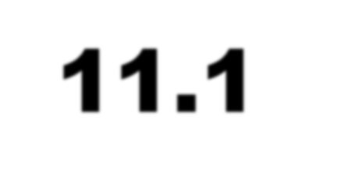

11.1 Paired Samples

Slide 9





Example 2
It was suspected that the amount of carbon monoxide CO (一氧化碳) in the air could increase the carboxyhemoglobin
(一氧化碳血紅素) level for patients with coronary artery (冠狀動脈) disease, which might cause angina (心絞痛) .
We wish to perform a hypothesis testing on the assumption that indeed the increased CO level would be a threat to patients with coronary artery disease.

Slide 10



Study design
Same individuals for taking the experiment (a longitudinal study).
Control group for having them breathe in normal air.
Experiment group for having them breathe in CO-rich air.
Which group would have a quicker onset of angina. That is, the time elapse to angina onset is shorter.
Note that ‘group’ here means different breathing conditions, not different people.

Slide 11



Cont’d
63 patients are randomly selected to measure the percent decreases in time to angina (our random variable) for each of the following two occasions. (See next slide)
More decrease in time to angina means quicker onset, which is more threatening.

Slide 12



Occasion #1 (control group):
On a given day, each individual exercises on a treadmill (跑步機) until the patient experiences angina, for which the onset time for angina t₁ was recorded.
The same patient (after experiencing angina at t₁) is exposed to plain room air for approximately 1 hour, followed by performing a second exercise test until the onset time for another angina t₂ was recorded.
Usually t₂ will be smaller than t₁, so t₁-t₂ would be a positive number.

Slide 13

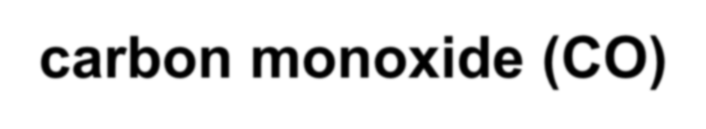
Occasion #2 (experiment group):
On another day, each individual again exercises on a treadmill (跑步機) until the patient experiences angina, for which the onset time for angina t₁ was recorded.
The same patient (after experiencing angina at t₁) is exposed to room air abundant with carbon monoxide (CO) for approximately 1 hour, followed by performing a second exercise test until the onset time for another angina t₂ was recorded.

Slide 14



We are interested in the “percent
decrease in time”
For example, if a patient was recorded t₁
= 983 and t₂ = 957 seconds in control group, we will have this value
983 − 957
= 0.026 = 2.6%
983
The same individual in experiment group has t₁ = 991 and t₂ = 900, then
991 − 900
= 0.092 = 9.2%
991
Larger means more threatening…

Slide 15


It is also possible that the two random variables are (+,─), (─,+) and (─,─).
For example, if a patient was recorded t₁
= 983 and t₂ = 957 seconds in control group, we will have this value
983 − 957
= 0.026 = 2.6%
983
The same individual in experiment group has t₁ = 991 and t₂ = 999(吸了CO變得更
強!!), then
991 − 999
= −0.008 = −0.8%
991
Larger means more threatening…

Slide 16


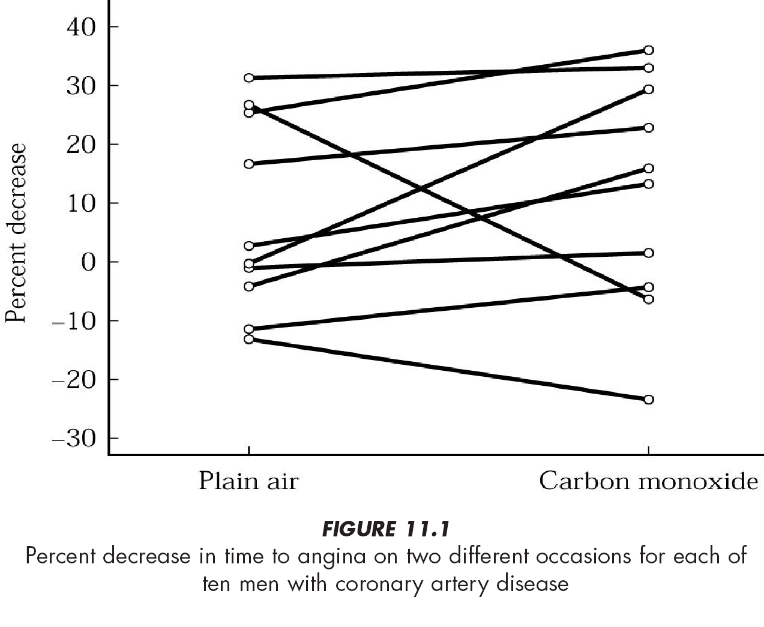

The matched pairs experiment
It looks like most of the pairs have the “percent decrease” up (i.e., earlier onset of angina in CO environment) instead of down.
Is such increase
significant?
Larger means more threatening…

Slide 17


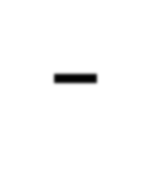








Matched Pairs Experiment –
initial statement
– Compare two populations of percent decreases in time to angina.
– The parameter tested is μ₁ − μ₂
2
Sample 1 |  |  | Sample
 | ^{x}11 x₂ x ⁝ |  |  | ^{x}12 ^{x}22 ^{x}32 ⁝ ^{x}n 2
Negative means threatening. More negative, more threatening…
μ
The population mean of percent decreases exposed to plain air
The population mean of percent decreases exposed to carbon Monoxide (CO)
1
μ₂

Slide 18

















The Null Hypothesis
We’d like to know whether indeed the increased CO level would be a threat to patients with coronary artery disease.
A threat can be interpreted as a quicker onset of second angina (a larger “percent decrease in time”, or μ₂ is greater than μ₁).
Let the null hypothesis be the following:
1: plain air
H₀: (μ₁ − μ₂) ≥ 0
2: carbon monoxide

Slide 19
Cont’d
This null hypothesis states that observations in sample 1 would be in general matching or greater than in sample 2.
Rejecting it would suggest otherwise. That is, sample 2 indeed gives significantly larger values of “percent decrease in time”
H₀: (μ₁ − μ₂) ≥ 0
H_{A}: (μ₁ − μ₂) < 0

Slide 20
The problem is…
How would we evaluate μ₁ − μ₂ as a random variable?
Computing μ₁ from sample #1 and μ₂ from sample #2 will not serve this purpose. [because it is a single observation, not a random variable]
We need to define a random variable representing the difference of “percent decrease in time” between two samples.

Slide 21

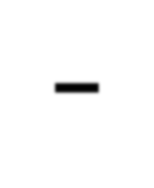



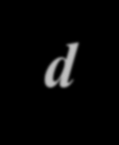
Matched Pairs Experiment – changing statement
Since the difference of the means is equal to the mean of the differences, we can rewrite the hypotheses in terms of δ (the mean of the differences) rather than in terms of μ₁ – μ_{2.}
^{x}11 ^{x}21
^{x}31 ^{x}41 ^{x}51 ^{x}61 ^{x}71
^{x}81
^{x}91
.
.
.
^{x}12 ^{x}22
^{x}32 ^{x}42 ^{x}52 ^{x}62 ^{x}72
^{x}82
^{x}92
.
.
.
Difference d
d₁ = x₁₁ − x₁₂
d₂ = x₂₁ − x₂₂ d₃ = x₃₁ − x₃₂
…
d_{n} = x_{n1} − x_{n 2}
⁝

Slide 22

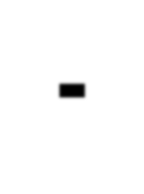


The paired t-test
Solution
δ =μ₁ – μ₂ is the “percent decrease in time”
The hypotheses:
H₀:
d = δ (= 0)
(i.e., no difference of angina onset)
H_{A}: δ < 0 (scenario #2 has bigger “percent decrease in time”, or early onset of angina)
– The t statistic:
Note that we changed δ
≧0 to δ =0 here!
d − δ
s_{d} n
t =

Slide 23























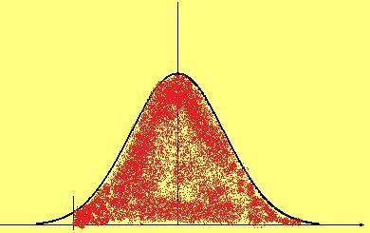








The paired t-test
The t-statistics
Mean values only
Mean values greater than 0
wouldn’t serve our purpose to show CO threat.
slightly less than 0 would suggest
μ₁ and μ₂ are comparable.
_{t =} d − δ
s_{d} n
For the null hypothesis to
match δ = 0, a negative
mean value of d would result _{t}
in a negative t towards the left tail. Further into the left tail would suggest to reject the null hypothesis that δ = 0.
This is a one-sided test with a left-tail.
.05,63-1
The rejection region is
^{t < t}.05,63-1
Degrees of freedom = n – 1
23

Slide 24
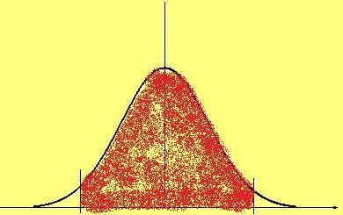
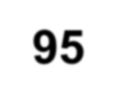

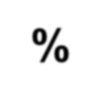
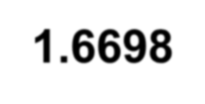
Computing t_{.05,63-1}
Recall that earlier we had the MATLAB function TINV giving this value t.
Note that we had a 2-tailed test then (left).
Now we have a one-sided test (right).
2.5%
5%
95%
95%
>> tinv(0.975,62) ans = 1.9990
>> tinv(0.05,62) ans =-1.6698

Slide 25


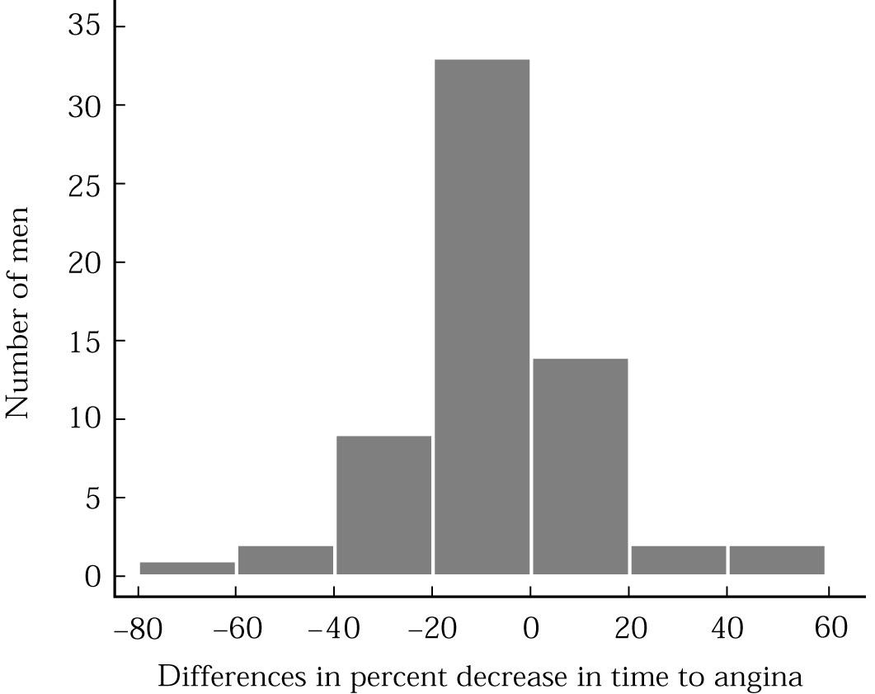

Checking the required conditions
for the paired observations case
The validity of the results depends on the normality of the differences. Indeed we have a fairly normal distribution here!

Slide 26


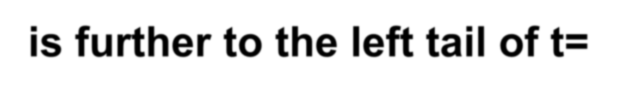

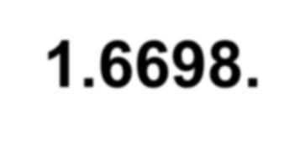
Matched Pairs Experiment –
implementation
Solution (given the following statistics)
∑
63
d
It is a negative value, which is good. But is it negative enough to reject the null hypothesis, so that we may ascertain that CO-environment promotes angina onset?
d =
i=1
i
= −6.63
63
s_{d} = 20.29
– Calculate t
_{t =} d − δ ₌ − 6.63 − 0 _{= −2.59}
s_{d} n 20.29 63
Rejecting the null hypothesis, since it is further to the left tail of t=-1.6698.

Slide 27

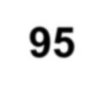
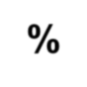

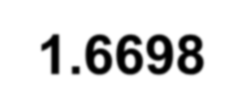
Computing p=P(t<−2.59)
Although we can immediately know to
reject the hypothesis when obtaining t =
−2.59 which is smaller than t_{.05,62} =
−1.6698, we can still use MATLAB to compute the p-value for this sample.
Below we use MATLAB in performing this computation.
>> tcdf(-2.59,62)
ans =
0.0060
5%
95%
>> tinv(0.05,62) ans =-1.6698

Slide 28
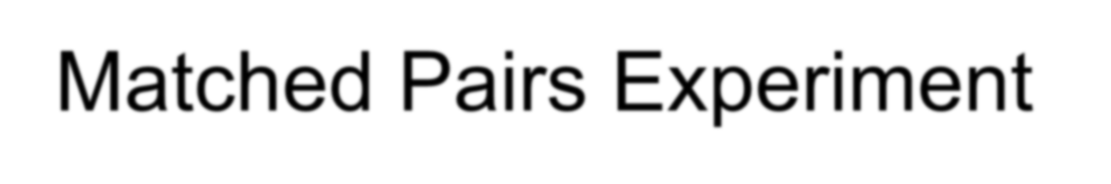
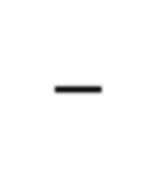

Matched Pairs Experiment – Conclusion
There is a significance difference of the mean percent decreases in time to angina between two exposures. [statistically different~~~]
Sample 2 apparently delivers larger percent decreases in time, suggesting patients exposed to CO would likely to have a quicker
onset of angina.
H₀: (μ₁ − μ₂) ≥ 0
H_{A}: (μ₁ − μ₂) < 0
28

Slide 29
Example 3 – BP changes upon using OC?
N | Systolic bp with no OC (x₁) | Systolic bp with OC (x₂) | d = x₂-x₁
1 | 115 | 128 | 13
2 | 112 | 115 | 3
3 | 107 | 106 | -1
4 | 119 | 128 | 9
5 | 115 | 122 | 7
6 | 138 | 145 | 7
7 | 126 | 132 | 6
8 | 105 | 109 | 4
9 | 104 | 102 | -2
10 | 115 | 117 | 2
>> x1=[115 112 107 119 115 138 126 105 104 115];
>> x2=[128 115 106 128 122 145 132 109 102 117];
>> d=x2-x1 =
13 3 -1 9 7 7 6 4 -2 2

Slide 30
>> mu=mean(d) mu = 4.8000
>> std=std(d)
std = 4.5656
>> t=(mu-0)/(std/sqrt(10))
t = 3.3247
>> 2*(1-tcdf(t,9)) ans = 0.0089
>>
The null hypothesis would
be d=0.
This is a 2-tailed test.
This is a t-test since no population standard deviation is available.
Degree of freedom is 10-
1=9.
Level of significant α = 0.05.
Since p is smaller than 0.05, we conclude that bp will change significantly (regardless increasing or decreasing) when using OC.

Slide 31


Comments
This example problem asked “whether BP changes upon using OC”. This is a 2- sided test since we did not ask whether BP will drop or rise.
If the problem asked “whether BP rises upon using OC”, then this would be a 1- sided test with a p-value half of what we obtained earlier. Still we’d reject the null hypothesis that the BP change equals to zero.

Slide 32







A Brief Summary
Here we covered “Chapter 11.1 – Paired Samples”:
For each observation on the first group, there is a corresponding observation in the second group. So we may reduce the problem to a one-sample test problem (using one difference of the mean, instead of two means from two samples).
In this case, the two samples are
paired (or dependent).

Slide 33


11.2 Independent Samples
In many cases, however, the two groups of measurements of interests are not paired. 【cross-sectional study…】
For example, we are interested in the serum iron level of two groups of children:
One group healthy (with mean μ₁)
The other group suffering from cystic fibrosis (囊腫性纖維化) (with mean μ₂)
Two types of populations are independent
and normally distributed.

Slide 34



The Null Hypothesis
We wonder if the two population means are equal. (That is, if the difference of serum iron level would attribute to this hereditary disease or not).
So the null hypothesis would be
H₀ : μ₁ − μ₂ = 0
or
H₀ : μ₁ = μ₂

Slide 35
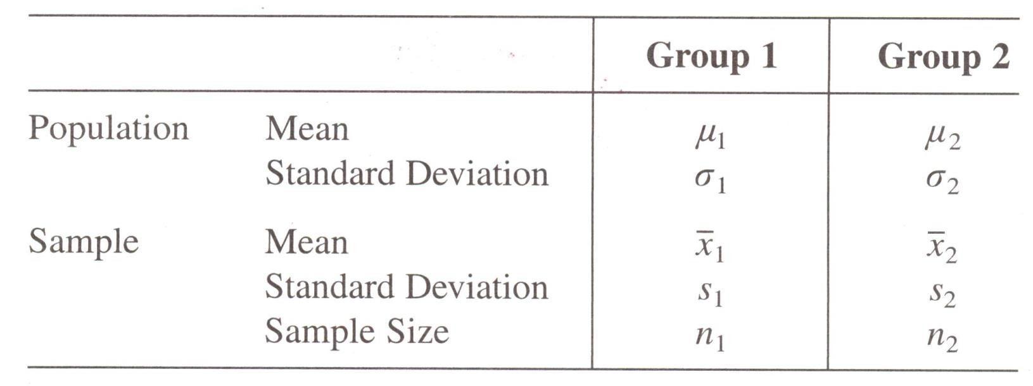
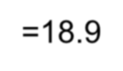
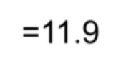
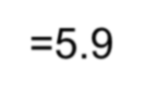
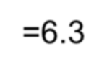
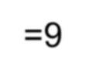
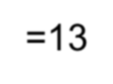
=18.9
=5.9
=9
=11.9
=6.3
=13
Two samples each was drawn from these two normally distributed populations, each with its own mean, STD and sample size.
We’d like to perform a t-test on the proposed null hypothesis
H₀ : μ₁ − μ₂ = 0

Slide 36



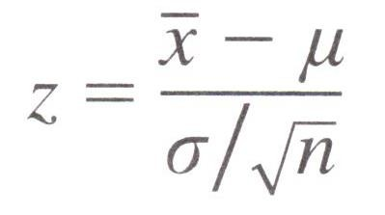
11.2.1 Equal Variances
We first assume that the two population variations are identical (i.e.,
σ₁ = σ₂ = σ)
By central limit theorem, we can perform the following conversion where the normally distributed x͞͞͞͞͞͞͞͞͞ would become a standard normal distribution z.

Slide 37



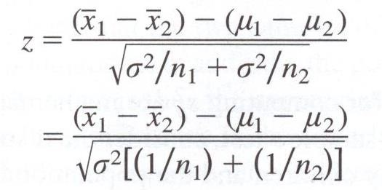
Cont’d
Since we are dealing with the samples from two independent normal distribution, we utilize an extension of the central limit theorem that the difference in means x͞͞͞₁−x͞͞͞₂ is approximately normal with mean μ₁−μ₂
and standard error
2
σ / n + σ ² / n
1 1 2 2
Since σ₁=σ₂=σ, we now have the z conversion as
Before…

Slide 38
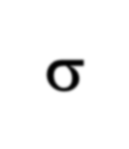



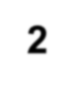
Cont’d
If the population variance σ² is known, we may use this z-statistics to test the proposed null hypothesis, as we have done before.
σ
n
Note the correct formula for the denominator (分母)
σ
n₁ + n₂

Slide 39






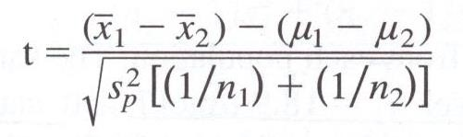






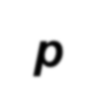

Using t-statistics
As noted earlier, it is much more common that the true value of σ² is not known. In this case, we use t-statistics instead of z-statistics:
where the new quantity s_{p} is a “pooled” estimate of the variance, which replaces
σ² used in the z-statistics.

Slide 40


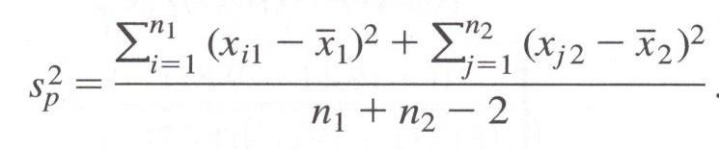
Computing s_{p}
2
The pooled estimate of the variance combines information from both samples to produce a more reliable estimate for the variance σ². (Recall we still assume that the two population variations are identical)
If we know all measurements in the samples, we may compute it by
❶
Similar to the formula of variance given before.

Slide 41
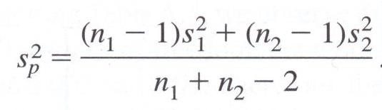

Cont’d
If the two standard variations (s₁ and s₂) of two samples are known, the previously formula can be easily replaced by
❷
One can see that this is actually a weighted average of the two sample variances s₁² and s₂².

Slide 42

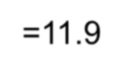
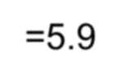

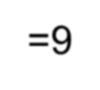
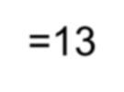
Example 4
Consider the two-group children example mentioned earlier:
=18.9
=5.9
=9
=11.9
=6.3
=13
We’d like to test whether children with cystic fibrosis (group 2) would have a level of iron in their blood on average as healthy children (group 1). There we test the
null hypothesis that the two population means are identical.

Slide 43



Solution
The null hypothesis states that there is no difference in the underlying population mean iron levels for the two groups of children.
Two-sided t-test will be performed, with a preset level of significance α=0.05.
H₀ : μ₁ − μ₂ = 0

Slide 44


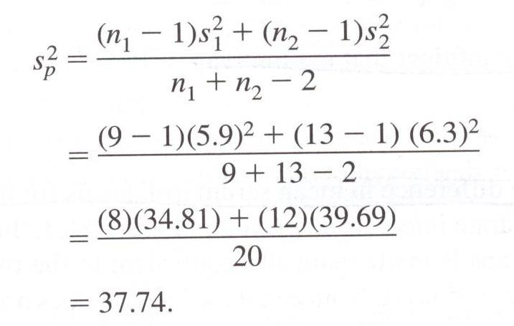
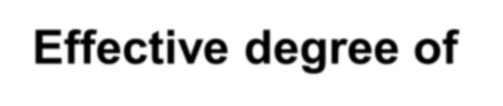




We first compute the pooled estimate of the variance using formula 2 we have seen earlier.
Effective degree of freedom when using t-correction

Slide 45
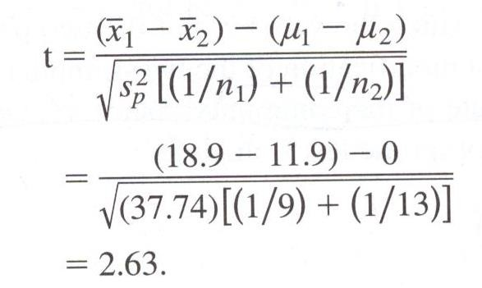
With this, we can now compute for the t- statistics:

Slide 46
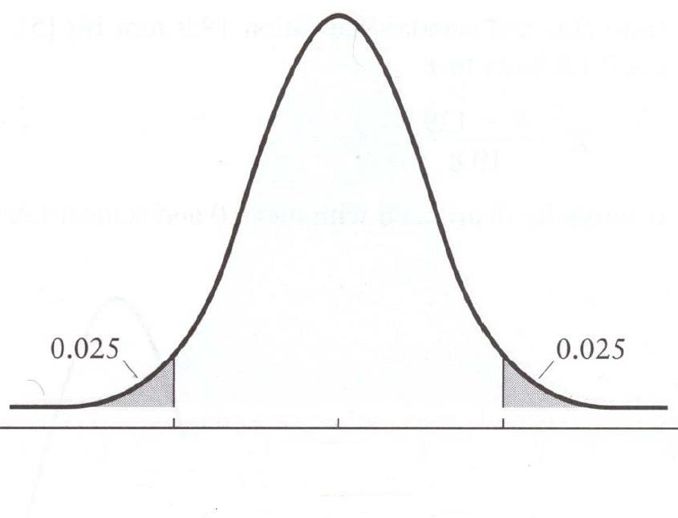
Two-sided distribution (df=20)
>> 1-tcdf(2.63, 20)
ans =
0.0080
>>
P-value = 0.008x2
= 0.016
t=2.63 tinv(0.975,20)=2.086
-2.086

Slide 47




Conclusion
We computed for a p-value of 0.016. This is smaller than α=0.05 for us to reject the null hypothesis.
That is, the difference between the mean serum iron level of healthy children (group 1) and ones with cystic fibrosis (group 2) is statistically significant.
Based on these samples, it appears that children with cystic fibrosis suffer from an iron deficiency.

Slide 48
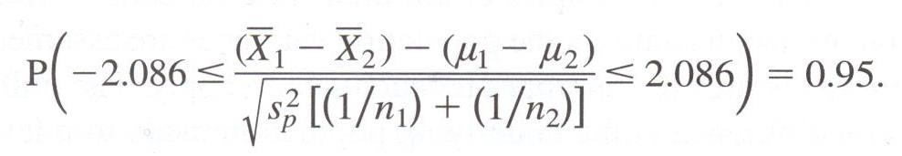
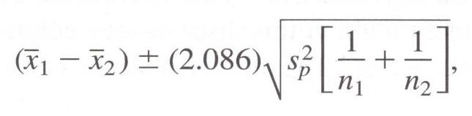
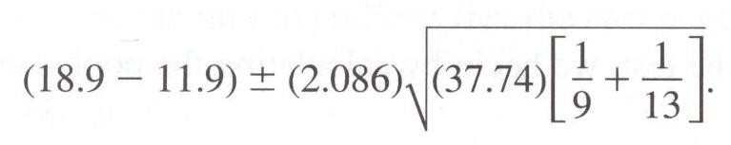
Estimating 95% CI for this difference of mean
So the 95% CI for μ₁−μ₂ can be computed as
, or

Slide 49


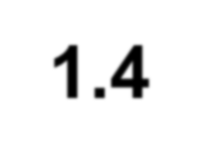
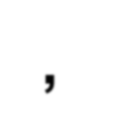
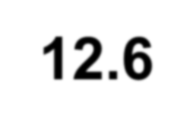
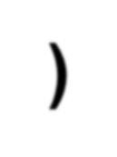



Cont’d
That is, we are 95% confident that the interval (1.4, 12.6) covers μ₁−μ₂, the true difference in mean serum iron levels for the two populations of children.
Note that the interval does not contain the value 0 (meaning that μ₁=μ₂), which is consistent with the result from the hypothesis testing we performed earlier.

Slide 50
μ₁−μ₂
= 7
t=-2.086
t=+2.086
5.6
5.6

Slide 51



Summary
The analysis we have seen in this lecture will pave way into Chapter 12, where we will do analysis of variance comparing two or more populations of interval data.
This is an extension of the two-sample t- test we have seen here to three or more samples.

Slide 52
11.2.2 Unequal Variances?
What if the two datasets do not have equal variance?
In other words, earlier mentioned using s_{p}² as an estimate of he common variance σ² won’t be valid.
1 2

Slide 53


σ₁ and σ₂.
A t-test must be used, and the standard error term now uses s₁ and s₂ rather than
The exact t-distribution is difficult to derive, and an approximation must be used to compute the “effective” degree of freedom to use the conventional t- distribution..

Slide 54

The value of v below is rounded to the nearest integer, which will serve as the degree of freedom when we approximate this distribution to a t-distribution.

Slide 55
Example 5
Effect of an anti-hypertensive drug against persons >= 60 yr who suffered from systolic blood pressure over 160 mmHg.
Group 1
subjects receiving active drug for one year.
Mean systolic BP = μ₁, unknown variation.
Group 2
subjects receiving placebo for one year
Mean systolic BP = μ₂, unknown variation and is different from group 1.

Slide 56







H₀: μ₁ = μ₂
H_{A}: μ₁ ≠ μ₂
=142.5
=15.7
=2308
=156.5
=17.3
=2293

Slide 57


Compute the test statistics:

Slide 58


Compute the “effective” degree of freedom:
4550 (rounding down to nearest integer)
We know t-distribution of df=4550 is practically the same as normal distribution.
t = -28.74 is far left to z = -1.96 which cuts the left tail at 2.5%. This concludes the difference is significant.

Slide 59
One may now compute twice the value of tcdf(- 28.74, 4550), which is the p-value for this test. The result is zero.
This concludes the patients receiving the drug do have a lower mean systolic blood pressure than those receiving placebo.
We may compute the 95% confidence interval of the difference of BP between these two samples as (-15.0, -13.0). [Verify this by yourself!!!]
This too helps in rejecting the hypothesis that two means are equal.

Slide 60











=142.5
=15.7
=2308
=156.5
=17.3
=2293
Note that the sample sizes are big. This effectively raises DF and the absolute value of t (ideal conditions to reject the null hypothesis).
What if the sample sizes are small, say, 10 each?

Slide 61
>> t=((x1-x2)-0)/sqrt(s1^2/10+s2^2/10) t = -1.8950
>> x1=142.5; x2=156.5; s1=15.7; s2=17.3;
>>
v=((s1^2/10+s2^2/10)^2)/((s1^2/10)^2/9+(s2^2/10
)^2/9)
v = 17.8331
>> 2*tcdf(t,v) ans = 0.0744
With this p-value, we cannot ascertain the two samples are having different mean values.

